Slide 1
Neural Networks and Fuzzy Logic - BITS F312
Text-guided Attention Model for Image Captioning
Submitted By:
Vikram Nitin (2015A7PS0042P)
Rohan Saxena (2015A7TS0017P)
Naveen Venkat (2015A7PS0078P)

Slide 2
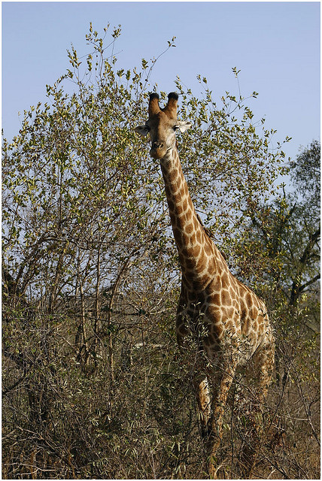
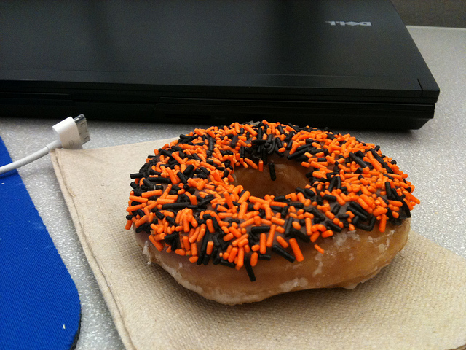
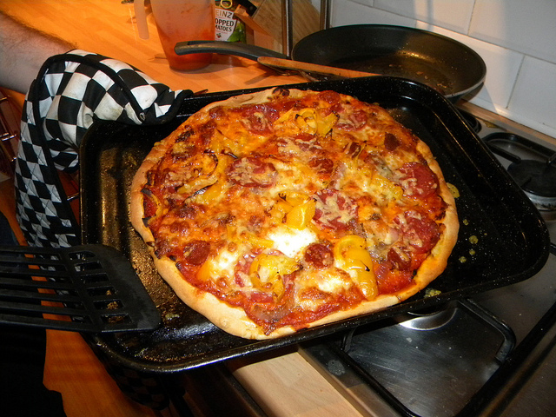
Introduction
Image captioning produces textual description of the image
“A pizza is kept on a plate”
“A donut is kept on the table”
“A giraffe is walking in a grassy field”

Slide 3

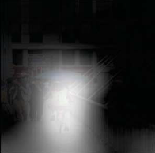
Attention based method
Focus only on the relevant locations while generating the captions
Blur out other regions
“A woman riding a bike down a street with an umbrella”
Whiteness: degree of importance of features

Slide 4
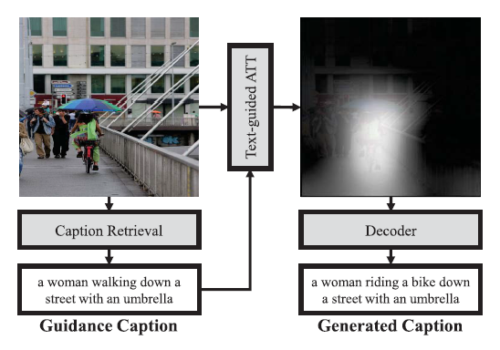
Text Guided Attention
Use “guidance captions” which can be retrieved from similar images, to guide the attention to specific regions of the image

Slide 5
Formulation of Problem & Objectives
Extract features from image that helps captioning
Use guidance captions to improve the accuracy of captions
Encode these two, pass through an attention model, give to decoder
Decoder will generate captions
Evaluate the accuracy

Slide 6
Source of Data
MS-COCO dataset (2014) :
123,287 images (82,783 training images and 40,504 validation images)
cocodataset.org

Slide 7
Libraries Used
Python
Keras
Tensorflow (backend)
CIDEr ( adapted form https://github.com/vrama91/cider )
Skip-Thought Vectors (Tensorflow provided: https://github.com/tensorflow/models/tree/master/research/skip_thoughts)
NLTK

Slide 8
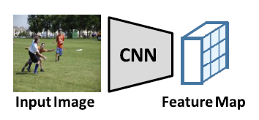
Feature Extraction
Extract features out of the image using convolution operation
CNNs used for analysis: VGG-FCN, Resnet-101
CNNs are fine tuned on MS-COCO dataset

Slide 9
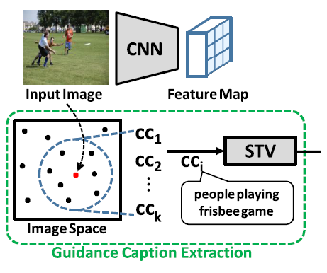
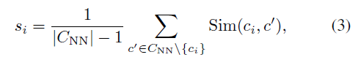
Guidance Caption
Nearest neighbors approach
Visually similar images tend to share the salient objects and events that are often described in their captions
C_{NN} : set of all closest captions
Sim(ci, c’) : CIDEr similarity score

Slide 10
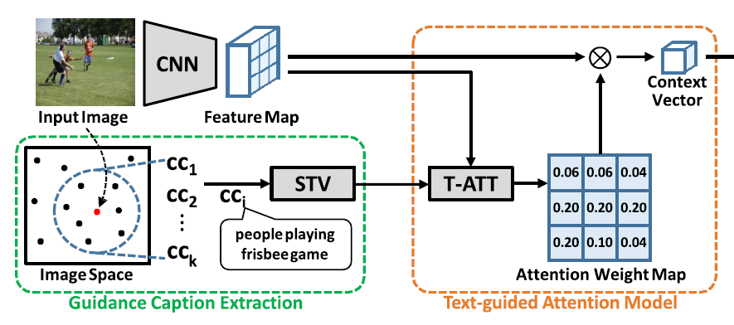
Text-guided Model

Slide 11
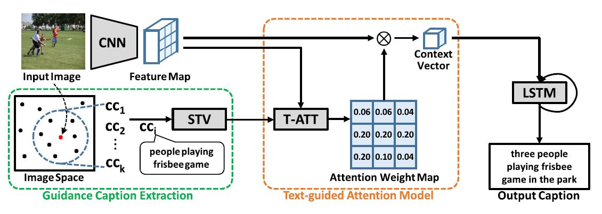
Architecture of the Network

Slide 12
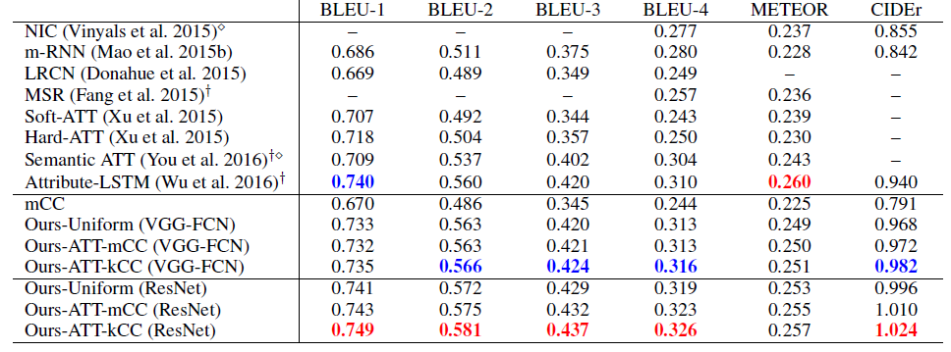
Performance on MS-COCO Dataset
red = best, blue = second best

Slide 13
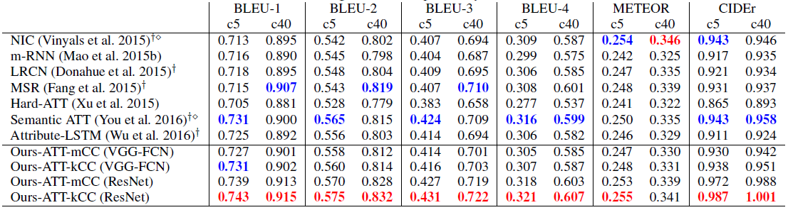
Performance on COCO image captioning challenge
red = best, blue = second best

Slide 14
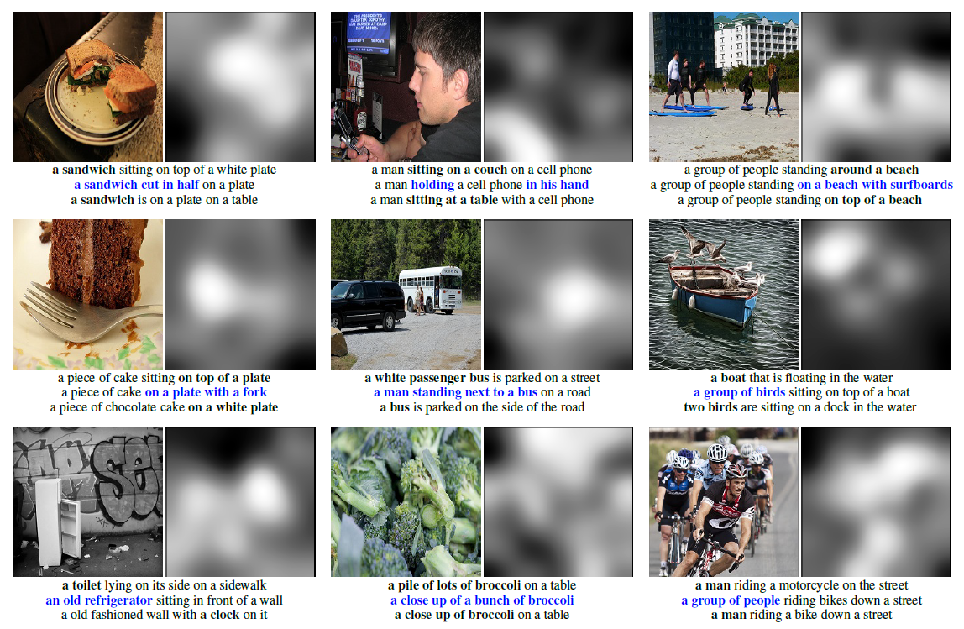

Slide 15
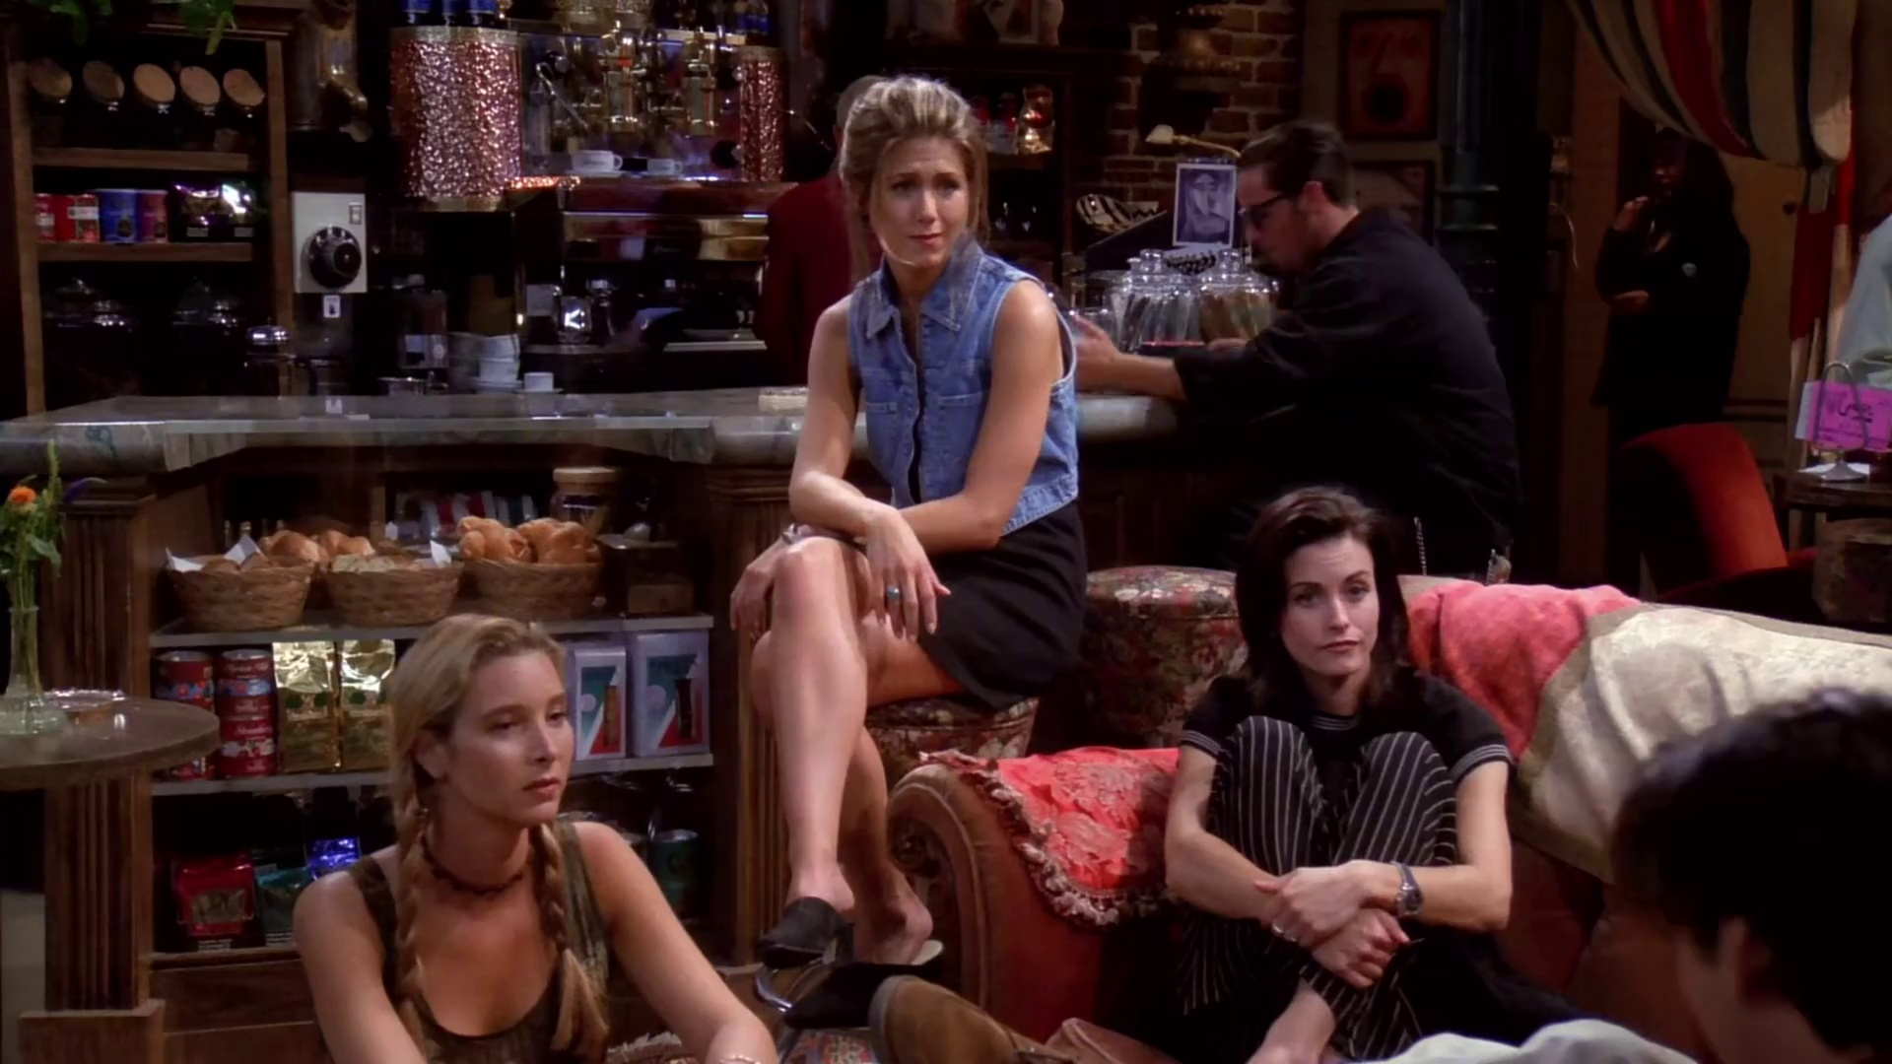
two women and a young girl pose in a kitchen

Slide 16
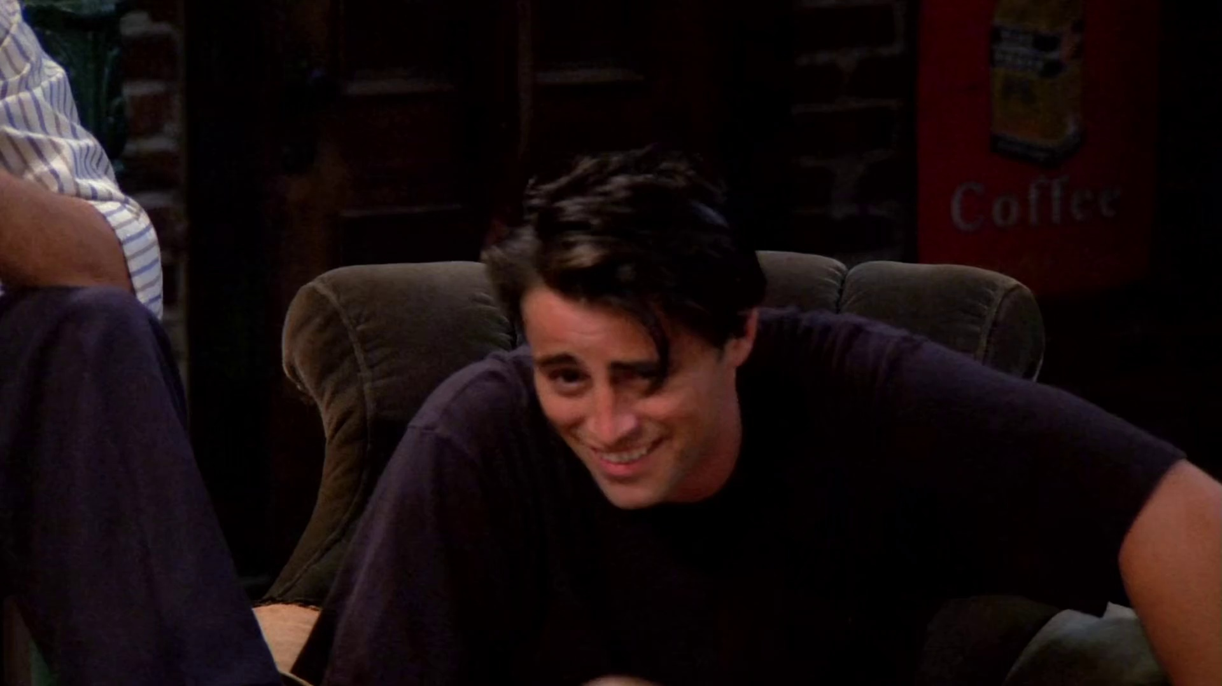
a man sitting in a chair talking on a cell phone

Slide 17
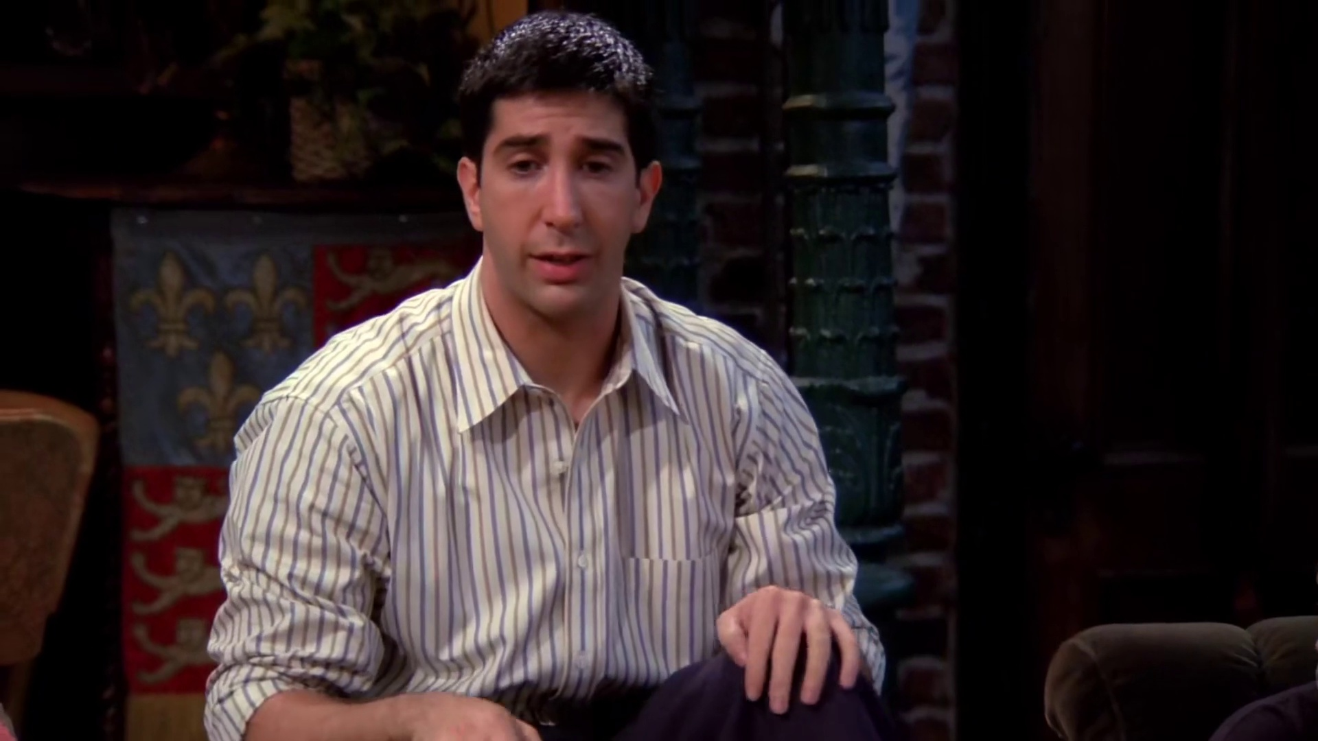
a man in a suit and bow tie looking at the camera

Slide 18
Conclusion
Text guided method provides “exemplar-based” learning method.
Guidance captions highlight the relevant regions
A set of consensus captions can be exploited to reduce noise

